Slide 1


Team 26: DC Motor Rotation Control Bi-Weekly Update 1
Zachary Bauman, Terrance Smith, Rodene Corpuz-Roxas, Josiah Thompson
Sponsor: Aniruddha Datta
TA: TBD

Slide 2
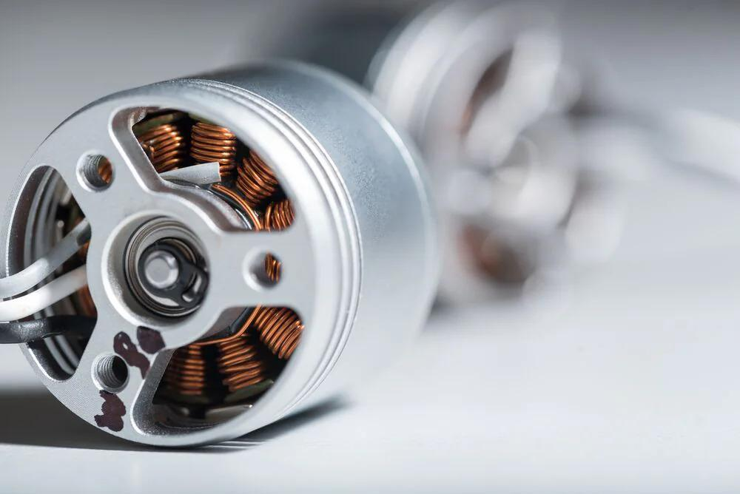
Project Summary
Problem statement:
Motors are everywhere, even in hazardous areas. And all motors need to be controlled even when an operator is not physically present.
Our Solution:
Create a custom DC motor controller that is safe and intuitive for the user.

Slide 3
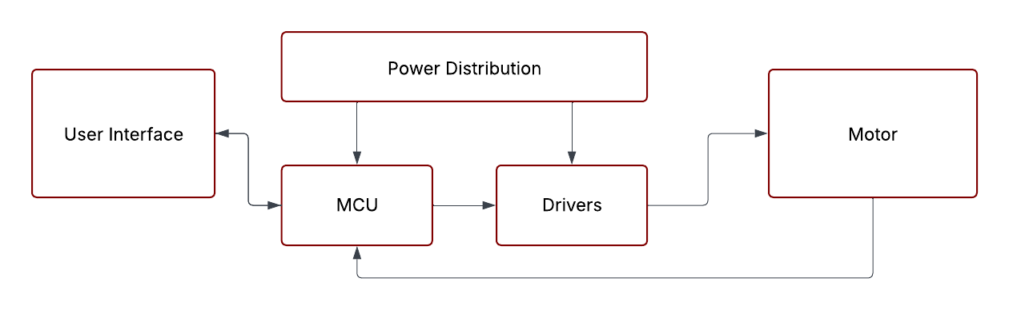
System Overview
Rodene Corpuz-Roxas
Bluetooth
Zachary Bauman
Terrance Smith
Josiah Thompson
Notes:
Cloud server and database

Slide 4
Major Project Changes for 404
Decreased the scope of the project to only the DC motor
Main control of only one motor
Notes:
Cloud server and database

Slide 5
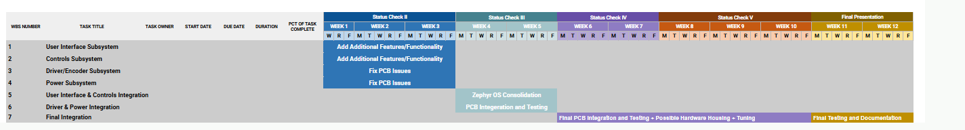
Project Timeline
Notes:
Cloud server and database

Slide 6
User Interface Subsystem
Zachary Bauman
Accomplishments since 403 4 hrs of effort | Ongoing progress/problems and plans until the next presentation
Source code documentation Increased the interface accessibility and user-friendliness | Bonding/Authorized Access Firebase Integration MCU Bootloader Over-the-air Firmware Updates

Slide 7
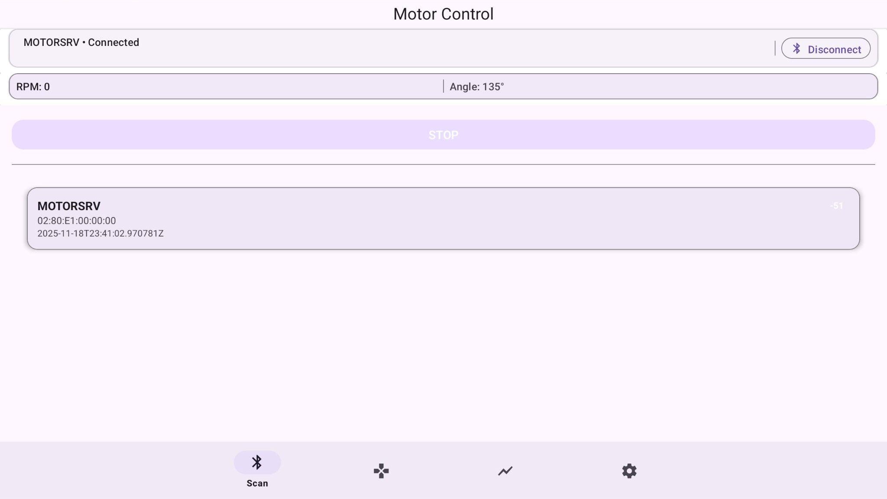
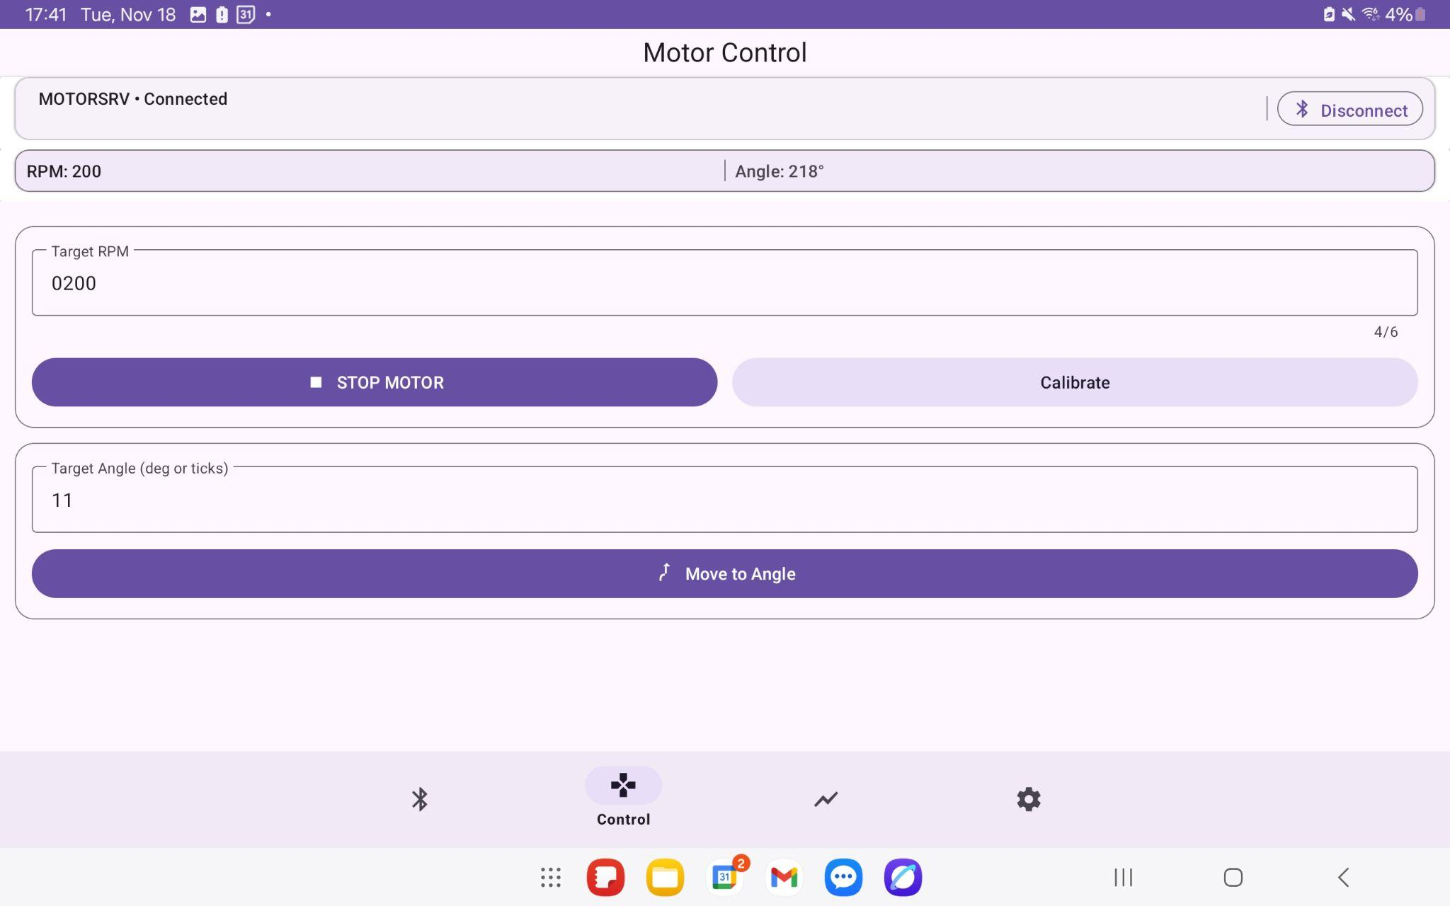
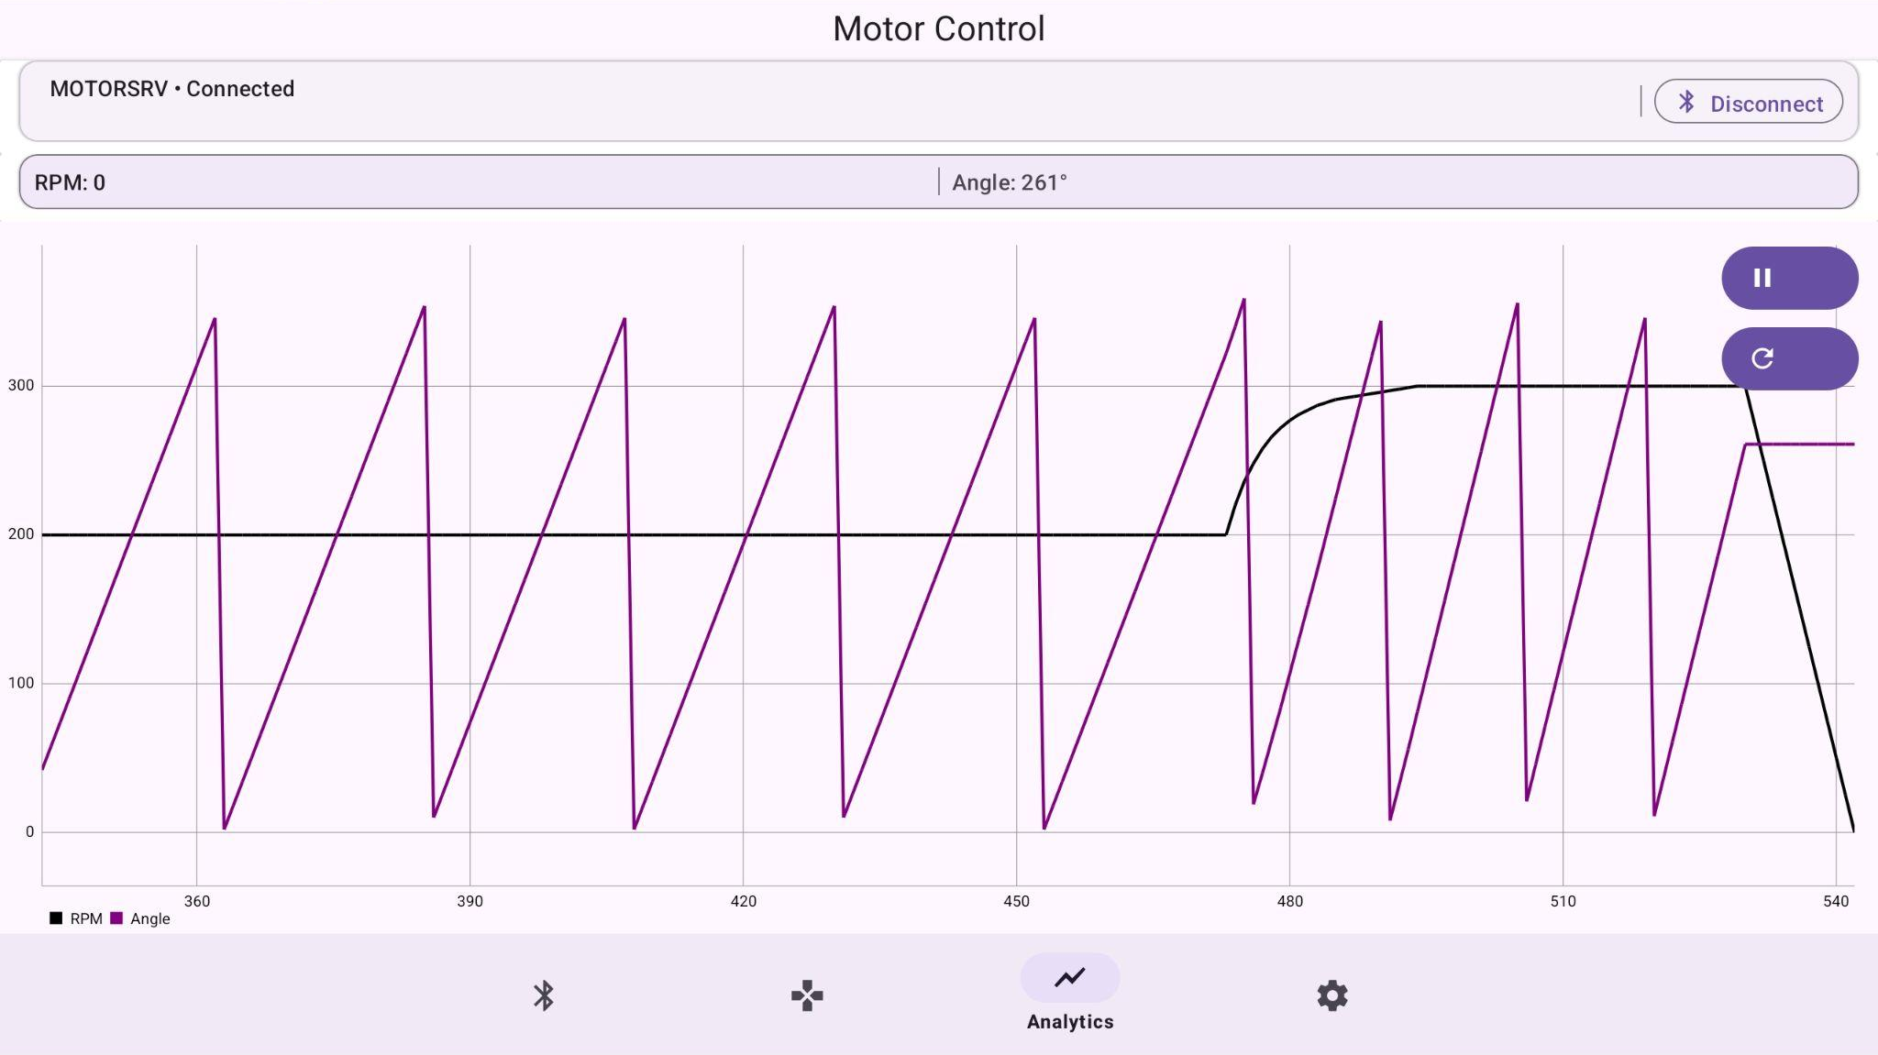

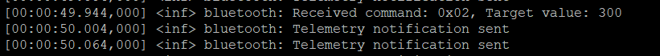

User Interface Subsystem
Zachary Bauman

Slide 8
Control Algorithm
Josiah Thompson
Accomplishments since 403 2 hrs of effort | Ongoing progress/problems and plans until the next presentation
MCU research Existing code review | Add coverage for edge cases in the algorithm Add bidirectional control Research position control requirements

Slide 9
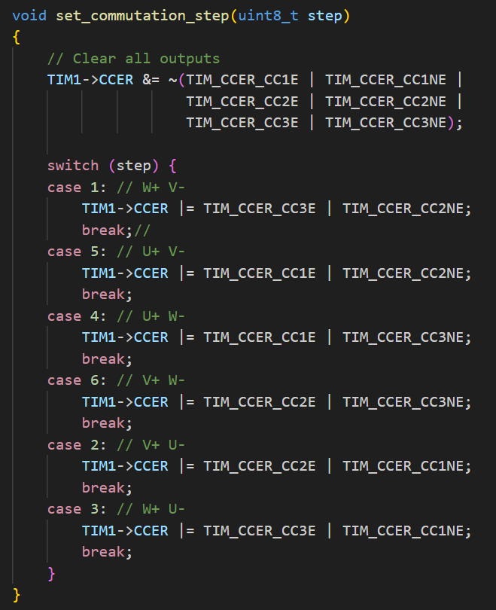
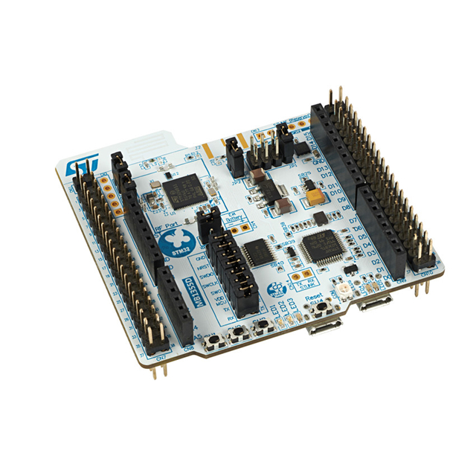
Control Algorithm
Josiah Thompson

Slide 10
Custom driver/controller
Terrance Smith
Accomplishments since 403 3 hours | Ongoing progress/problems and plans until the next presentation
-Diagnosed the component error | -Fix exact pcb component to allow NMOS to fully activate -Add buck converter to pcb design

Slide 11
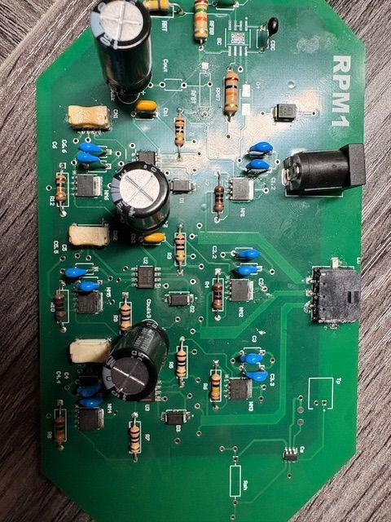
Custom Controller/Driver
Terrance Smith
MOSFETS are becoming source followers.
Bootstrap capacitors are not charging up.

Slide 12
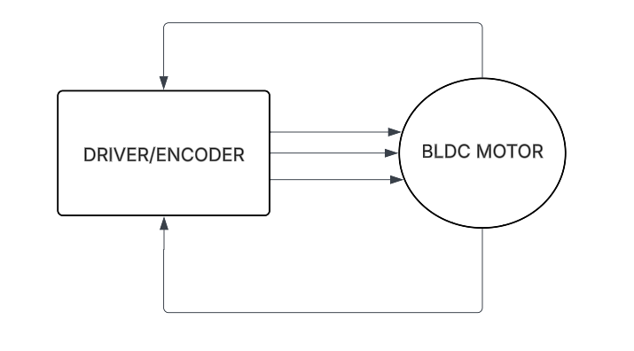
Custom Driver/Encoder Subsystem Overview
403 Deliverables
Converts PWM outputs into readable signal for motor response
Able to produce all 6-steps of motor control
Floating Phase receives and records the back-EMF from motor
PWM phase holds and charges Boot Capacitor

Slide 13
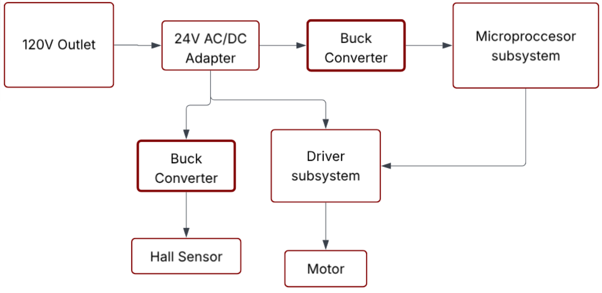
Power Rodene
PCB is tasked with converting wall input into output power supply for control system

Slide 14
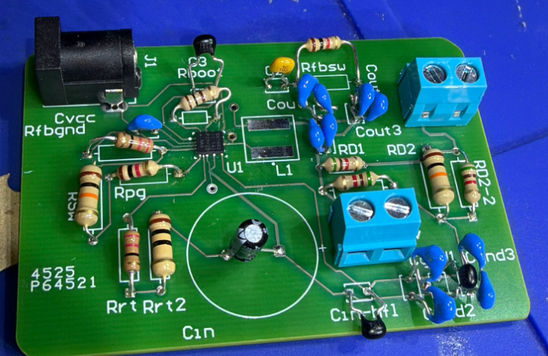
Power Rodene

Slide 15
Power Rodene Corpuz-Roxas
Accomplishments since 403 2 hours | Ongoing progress/problems and plans until the next presentation
Currently have a non-functional PCB, but circuit schematic passes simulation expectations Diagnosed where PCB failed | Redesign PCB ground (trace widths/placements) Reorder PCB and respective components

Slide 16
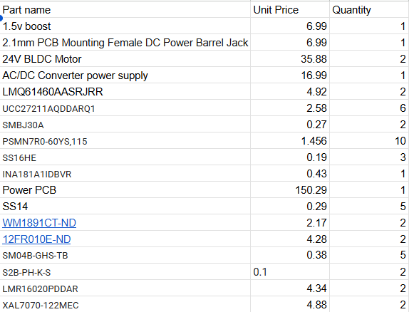
Parts Ordering Status
Inventory check for remaining spare parts. PCB orders will be placed by friday along with any necessary parts needed for circuits. Desired day to receive parts will be Wednesday-Thursday.
Notes:
Michelle

Slide 17
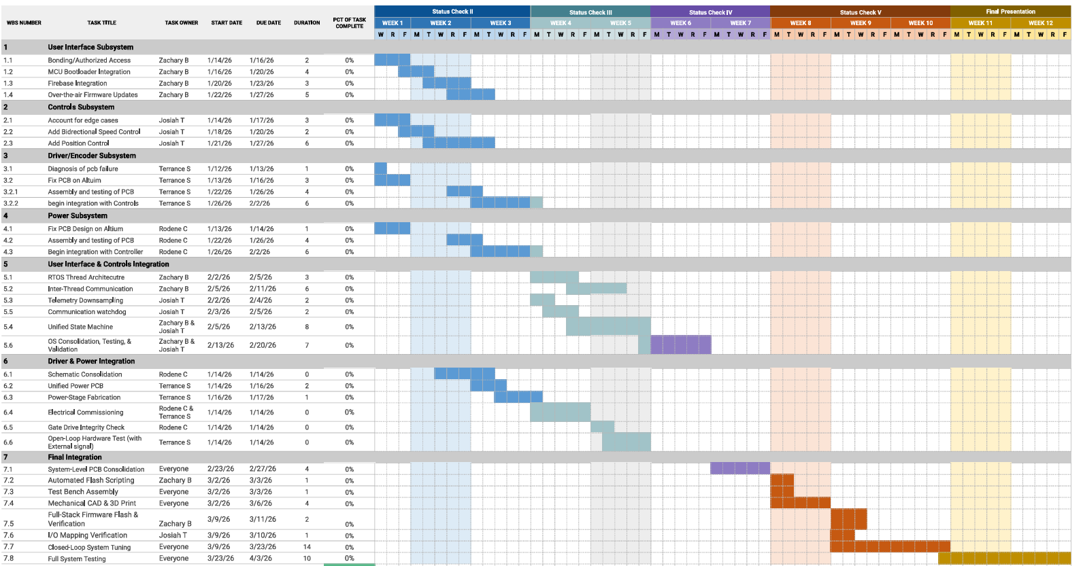
Execution & Plan
Notes:
Michelle

Slide 18
Team 26: RPM1
Thanks & Gig’em
‹#›

